Slide 1
Natural Language Processing
Week 11

Slide 2
Good evening, everyone. Welcome to the live session.
Today, we will be practicing problems from the current week’s content.
We will wait 5 minutes for everyone to join in and start at 7:05 pm.

Slide 3
Question 1: Your teacher recommended you to read the book ’Natural Language Processing with Python’. After reading the book, you want to summarize it. What kind of summarization method would you use for this purpose?
1. Abstractive single document summarization
2. Abstractive multi document summarization
3. Extractive single document summarization
4. Extractive multi document summarization
a. 1, 2
b. 3, 4
c. 1, 3
d. 2, 4

Slide 4
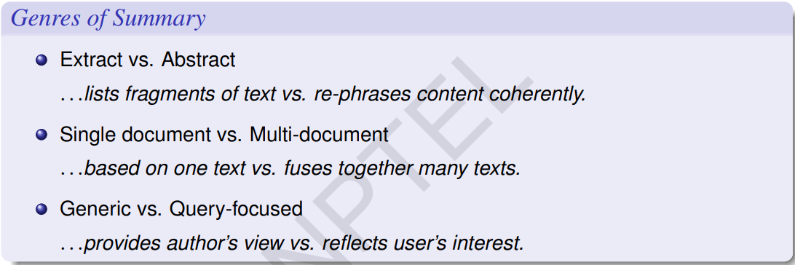
Solution
Answer: C

Slide 5
Question 2: What kind of summarization approach is lexrank?
a. Extractive multi document generic
b. Extractive multi document query specific
c. Abstractive multi document query specific
d. Abstractive multi document generic

Slide 6
Solution
Answer: a

Slide 7
Question 3: Identify whether the following statements are True or False.
1. Maximum Marginal Relevance strives to reduce redundancy while maintaining query relevance.
2. Query-focused summarization can be thought of as a complex question-answering system.
a. True, False
b. True, True
c. False, True
d. False, False

Slide 8
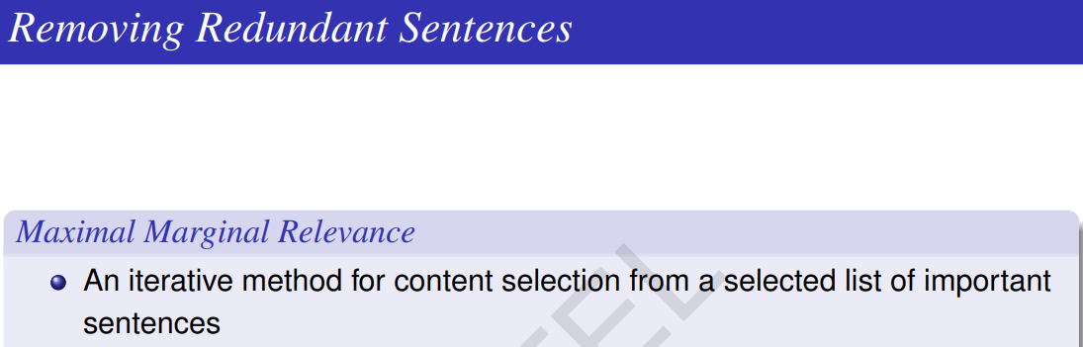
Solution
Answer: b

Slide 9
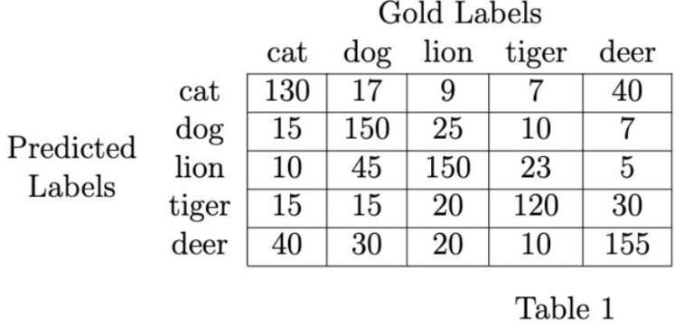
For question 4-8, use the data given in Table 1.
Suppose you have trained a image classifier with 5 classes - cat, dog, lion, tiger, and deer. Consider the confusion matrix shown in Table 1.

Slide 10
Question 4: What is the macro averaged precision?
a. 0.6696
b. 0.6078
c. 0.6433
d. None of the above

Slide 11
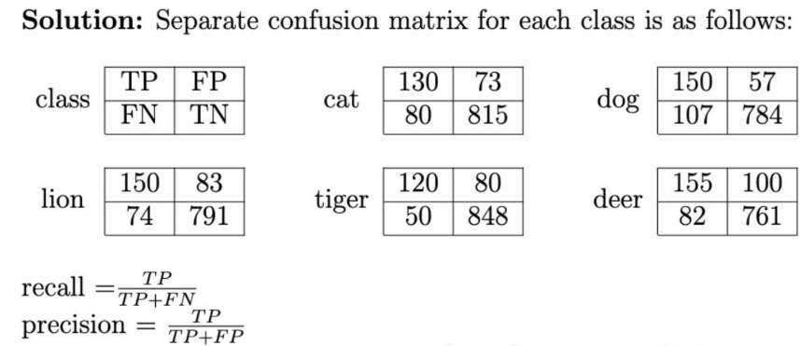
Solution
Answer: c

Slide 12
Question 5: What is the macro averaged recall?
a. 0.6464
b. 0.6540
c. 0.6190
d. None of the above

Slide 13
Solution
Answer: a

Slide 14
Question 6: What is the accuracy of your classifier?
a. 0.6421
b. 0.6536
c. 0.6319
d. None of the above

Slide 15
Solution
Answer: a

Slide 16
Question 7: What is the micro averaged precision?
a. 0.6915
b. 0.6421
c. 0.6245
d. None of the above

Slide 17
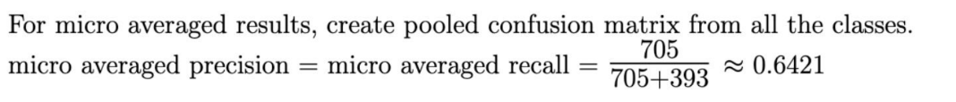
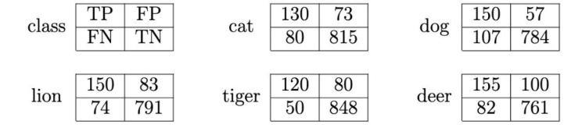

Solution
Answer: b
Micro Avg. Table
Micro averaged precision = 705/(705+393) = 0.6421

Slide 18
Question 8: What is the micro averaged recall?
a. 0.6190
b. 0.6535
c. 0.6421
d. None of the above

Slide 19
Solution
Answer: c
Micro Avg. Table
Micro averaged recall= 705/(705+393) = 0.6421

Slide 20
Question 9: It is estimated that 20% of ChatGPT generated texts are fake. Some AI system has been applied to filter these fake contents. An AI system claims that it can detect 98% of fake contents, and the probability for a false positive (a real content detected as fake) is 3%. Now if a content is detected as fake, then what is the probability that it is in fact a real content?
a. 0.084
b. 0.109
c. 0.119
d. None of the above

Slide 21
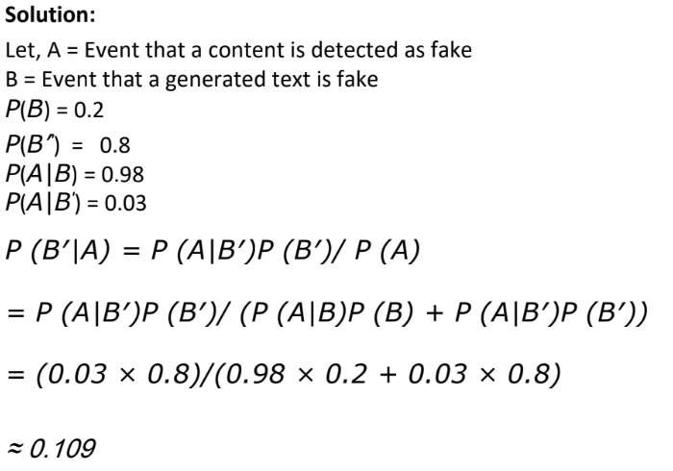
Solution
Answer: b

Slide 22
Question 10: Consider the system generated summary (S) and the reference summary as follows:
S: ChatGPT is powered by deep learning, a technique that involves training a neural network with extensive data.
R: ChatGPT is deep learning model that uses a neural network to understand language patterns.
What is the ROUGE-1 recall for the given summary with respect to the reference?
a. 0.500
b. 0.571
c. 0.470
d. None of the above

Slide 24
Solution
Answer: b
Solution: ROUGE-1 recall = Matching unigrams in the reference and system generated summary / No. of unigrams in the reference summary = 8/14 = 0.5714
S: ChatGPT is powered by deep learning, a technique that involves training a neural network with extensive data.
R: ChatGPT is deep learning model that uses a neural network to understand language patterns.

